Slide 1




Evoluzione dell’oagb…controversie
Dott.ssa Francesca Abbatini MD,PHD
u.O.C. Chirurgia generale e d’urgenza Ospedale dei castelli,ariccia(RM)
direttore dott. angelo serao

Slide 2
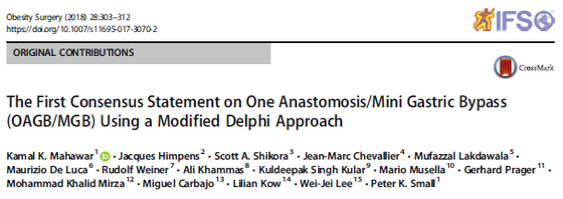
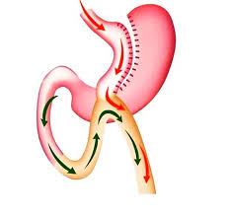
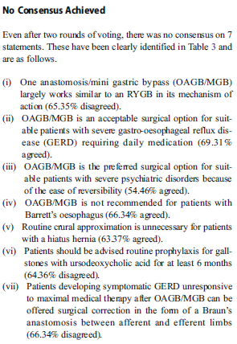

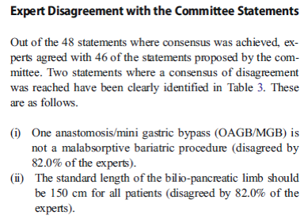
-101 OAGB/MGB experts from 39 countries
-55 statements in areas of controversy or variation
-consensus was achieved for 48/ 55 proposed statements

Slide 3


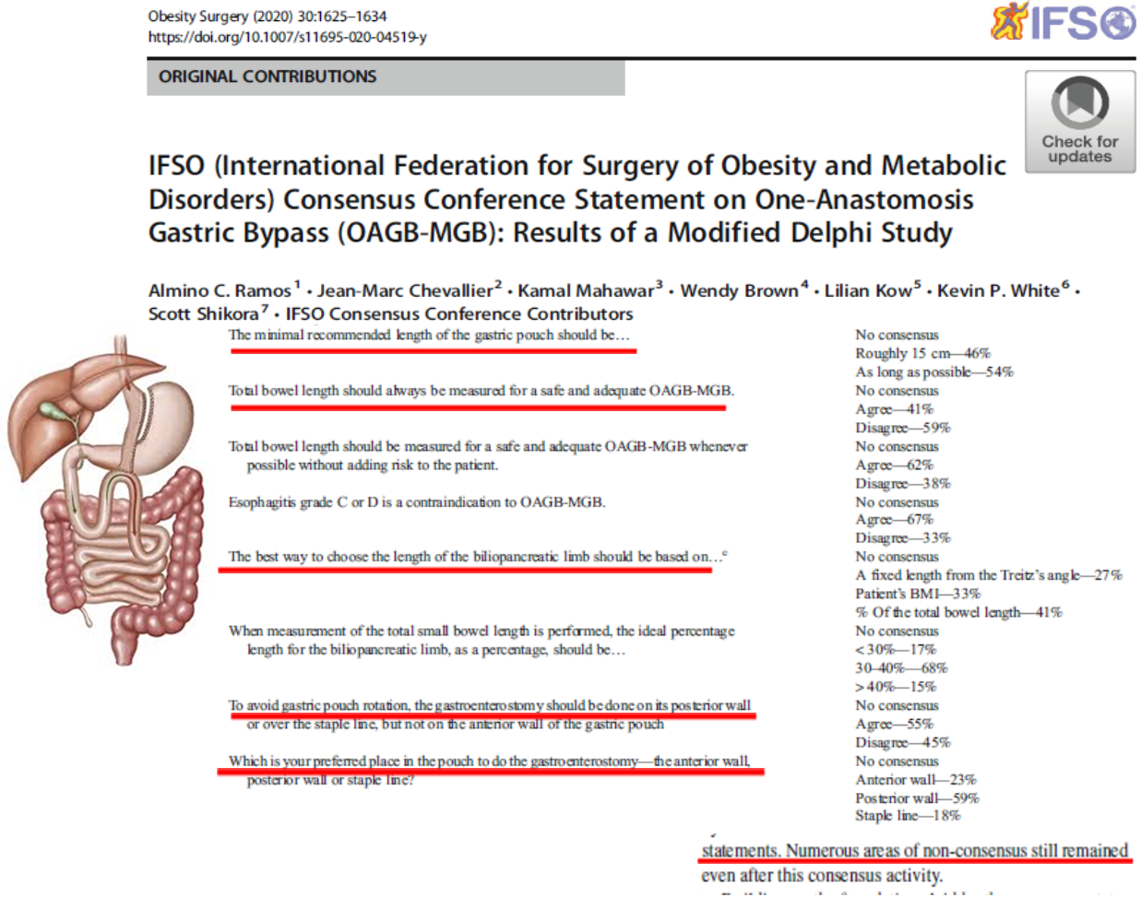



Slide 4
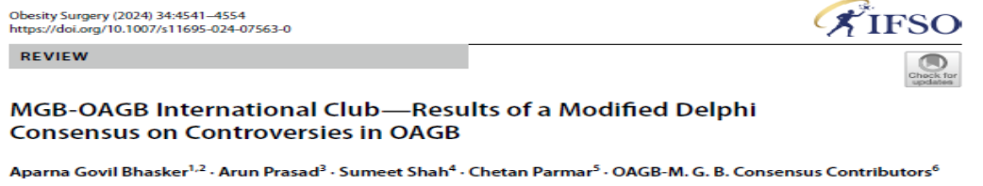


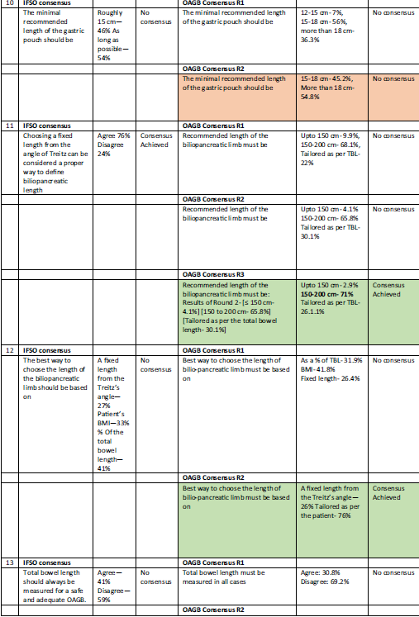
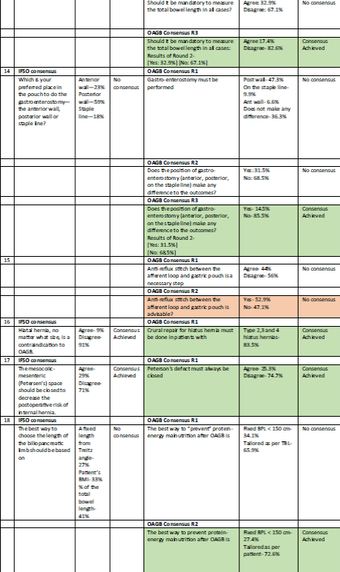



86 surgeons from 25 countries.
69.7% of the experts were from the Asia Pacific region, where OAGB is most commonly performed

Slide 5
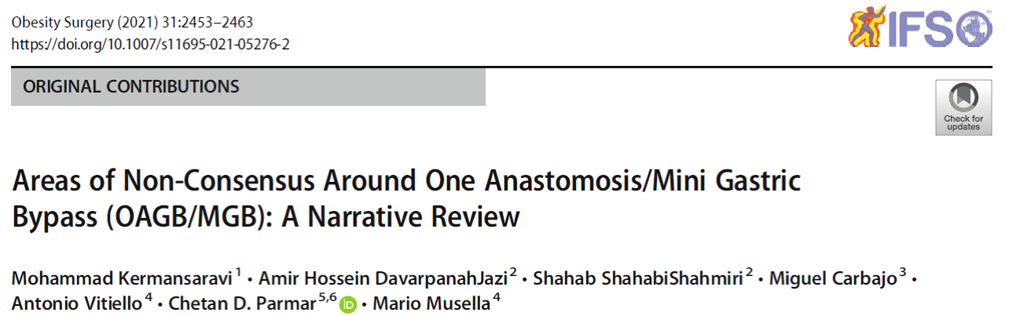
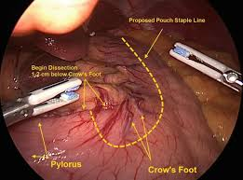
TASCA GASTRICA
1)Calibro della sonda oro-gastrica (32-50Fr)
2)Ingresso nel piccolo omento e prima staplerata: -1-2 cm distalmente alla zampa
d’oca
- parte più bassa dell’incisura
angularis fino a 5 cm dal piloro
- sopra la zampa d’oca
3)Lunghezza della tasca gastrica: argomento dibattutto 18cm?, 12-18 cm?, >15 cm?,
Deve essere più lunga possibile, almeno 15 cm in quanto una tasca gastrica troppo corta predispone ad insorgenza di MRGE

Slide 6
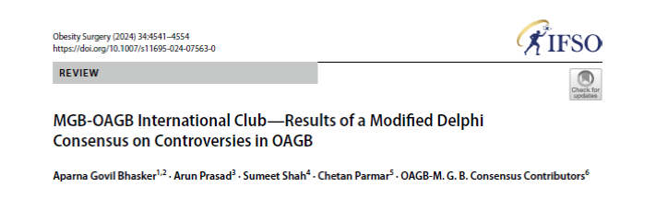
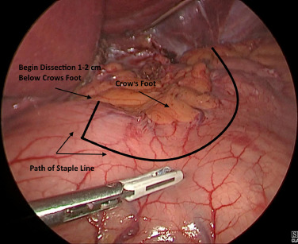
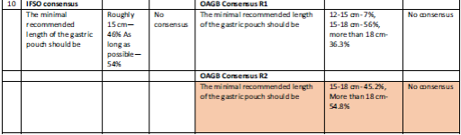


Slide 7
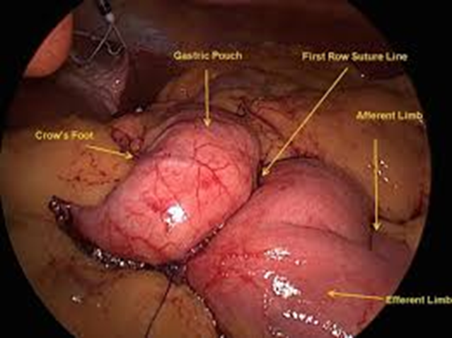
ANASTOMOSI GASTRO-DIGIUNALE
Suturatrice lineare + sutura in continua con materiale assorbibile
Lunghezza anastomosi: 25mm, 40mm, 60 mm
Sutura: preferenza del chirurgo (Vicryl 2-0, V-Loc 2-0, PDS 2-0), assorbibile materiale più utilizzato
Anastomosi manuale
Anastomosi sulla parete posteriore gastrica nella maggior parte dei lavori
Qualche caso di anastomosi sulla parete anteriore
Areas of Non-Consensus Around One Anastomosis/Mini GastricBypass (OAGB/MGB): A Narrative Review
Mohammad Kermansaravi et al., Obesity Surgery (2021) 31:2453–2463

Slide 8
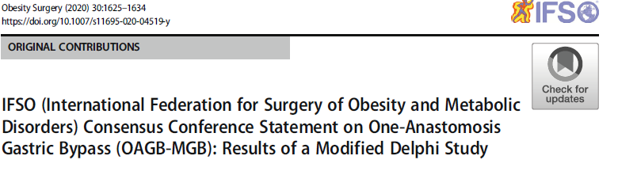
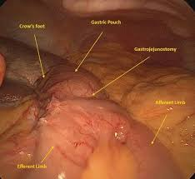


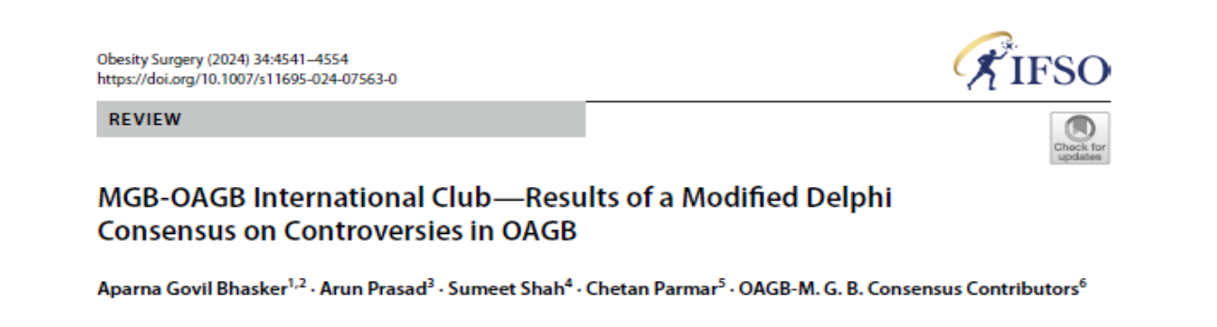




Slide 9
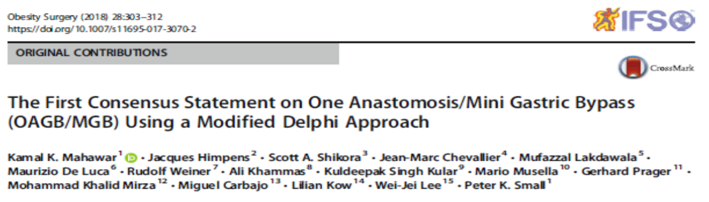
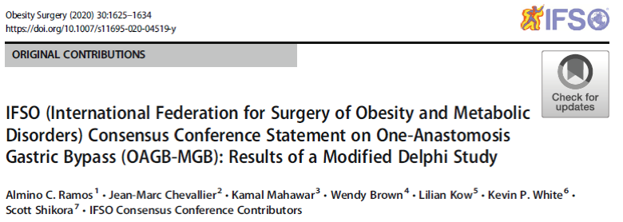
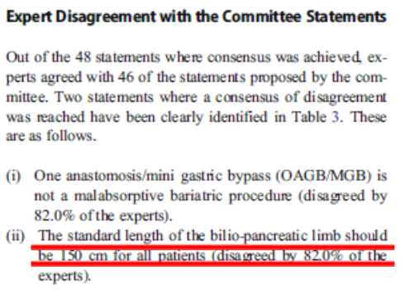

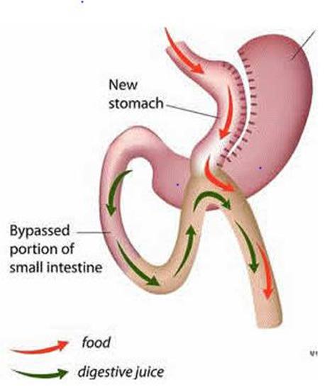

Slide 10


MISURAZIONE DELLA LUNGHEZZA TOTALE DELL’INTESTINO TENUE
MOLTO DIBATTUTA LA LUNGHEZZA DELL ‘ANSA BILIO-PANCREATICA
ANSA BILIARE DI 200 CM O PIU’ LUNGA AUMENTA IL RISCHIO DI MALASSORBIMENTO E MALNUTRIZIONE PROTEICO-CALORICA E DOVREBBE ESSERE ESEGUITA DOPO MISURAZIONE DELL’INTERA LUNGHEZZA DI TENUE (Ramos AC, et al. IFSO (International Federation for Surgery of Obesity and Metabolic Disorders) consensus conference statement on one-anastomosis gastric bypass (OAGB-MGB): results of a modified Delphi study. Obes Surg. 2020;30(5):1625–34.
CARBAJO MISURAVA LA LUNGHEZZA DI TUTTO IL TENUE E CONFEZIONAVA L’ANASTOMOSI G-D CON LA PORZIONE CENTRALE.RACCOMANDANDO CHE LA LUNGHEZZA DELL’ANSA BILIOPANCREATICA DOVESSE ESSERE CUCITA IN BASE ALLE CARATTERISTICHE DEL PAZIENTE, UTILIZZANDO DAL 40 AL 60% DI TENUE, CHE POTREBBE ESSERE DIFFERENTE IN RELAZIONE AI VARI GRADI DI OBESITA’ (Carbajo MA et al. Laparoscopic one-anastomosis gastric bypass: technique, results, and long-term follow-up in 1200 patients. Obes Surg. 2017;27(5):1153–67 Ruiz-Tovar J, CarbajoMA, Jimenez JM, et al. Are there ideal smallbowel limb lengths for one-anastomosis gastric bypass (OAGB) To obtain optimal weight loss and remission of comorbidities withminimal nutritional deficiencies? World J Surg. 2020;44(3):855)
SOONG ET AL. RACCOMANDAVANO LA MISURAZIONE ROUTINARIA DI TUTTO IL TENUE, MANTENENDO L’ANSA COMUNE DI ALMENO 400 cm. PER RIDURRE L’INCIDENZA DI MALNUTRIZIONE SENZA COMPROMETTERE L’EFFETTO SULLA PERDITA DI PESO E SULLA RISOLUZIONE DEL DIABETE (Soong TC, Almalki OM, Lee WJ, et al. Measuring the small bowel length may decrease the incidence of malnutrition after laparoscopic one-anastomosis gastric bypass with tailored bypass limb. Surgery for Obesity and Related Diseases : official journal of the American Society for Bariatric Surgery. 2019;15(10):1712–8. )
LA MISURAZIONE DI TUTTO IL TENUE NON E’ SCEVRA DA RISCHI. AUMENTO DEI TEMPI OPERATORI E DEL RISCHIO DI LESIONI IATROGENE MISCONOSCIUTE SOPRATTUTTO IN PAZIENTI CON BMI ELEVATO
NON ESISTE UN METODO PRECISO DI MISURAZIONE DELL’INTESTINO, CHE VARIA DA CHIRURGO A CHIRURGO (Genser L, al. Laparoscopic reversal of mini-gastric bypass to original anatomy for severe postoperative malnutrition. Langenbeck's Arch Surg. 2017;402(8):1263–70.)

Slide 11

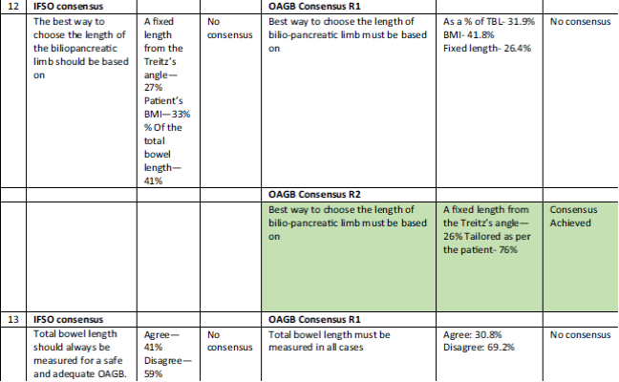
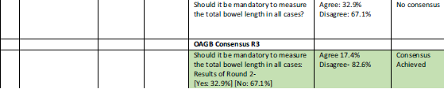

Slide 12

ANSA BILIO-PANCREATICA
-LUNGHEZZA VARIABILE DA 100 A 400 cm, ANCORA DIBATTUTA
-LUNGHEZZA FISSA NON APPROPRIATA PER OBESI CON AMPIA VARIABILITA’ DI BMI
-SCEGLIERE LA LUNGHEZZA IN BASE AL BMI
(LeeWJ,WangW, Lee YC, et al. Laparoscopic mini-gastric bypass: experience with tailored bypass limb according to body weight.
Obes Surg. 2008;18(3):294–9.; Kermansaravi M, Pishgahroudsari M, Kabir A, et al. Weight loss after one-anastomosis/mini-gastric bypass-the impact of biliopancreatic limb: a retrospective cohort study. Journal of
Research in Medical Sciences : the official journal of IsfahanUniversity of Medical Sciences. 2020;25:5.)
-NOUN ET AL. AUMENTAVANO LA LUNGHEZZA DELL’ANSA DI 10 cm AD OGNI AUMENTO DI BMI SOPRA 40 (Noun R, Skaff J, Riachi E, et al. One thousand consecutive minigastric bypass: short- and long-term outcome. Obes Surg.2012;22(5):697–703.
-LEE ET AL., JAMMU ET AL., KERMANSARAVI ET AL ., 180 cm 35-39 BMI
200 cm 40-50 BMI
220 cm >50 BMI RIDUCENDO DI 10 cm LA LUNGHEZZA OGNI 5 AA SOPRA I 45 AA (Leeet al. Laparoscopic Roux-en-Y vs. minigastricbypass for the treatment of morbid obesity: a 10-year experience. Obes Surg. 2012;22(12):1827–34; Jammu GS, Sharma R. A 7-year clinical audit of 1107 cases comparing sleeve gastrectomy, Roux-En-Y gastric bypass, and minigastric bypass, to determine an effective and safe bariatric and metabolic procedure. Obes Surg. 2016;26(5):926–32.; Kermansaravi M, Pishgahroudsari M, Kabir A, et al. Weight loss after one-anastomosis/mini-gastric bypass-the impact of biliopancreatic limb: a retrospective cohort study. Journal of Research in Medical Sciences : the official journal of Isfahan University of Medical Sciences. 2020;25:5.)
STESSI RISULTATI SULLA PERDITA DI PESO CON ANSA DI 150 cm e 200 cm (Boyle M, Mahawar K. One anastomosis gastric bypass performed with a 150-cm biliopancreatic limb delivers weight loss outcomes similar to those with a 200-cm biliopancreatic limb at 18 -24 months. Obes Surg. 2020;30(4):1258–64.)
NO CONSENSUS SULLA PERCENTUALE DI LUNGHEZZA IDEALE DELL’ANSA BILIOPANCREATICA MISURANDO LA LUNGHEZZA DI TUTTO IL TENUE
-IFSO OAGB/MGB CONSENSUS RACCOMANDAZIONE: 30-40% DELLA LUNGHEZZA TOTALE DEL TENUE (Ramos AC, Chevallier JM, Mahawar K, et al. IFSO (International Federation for Surgery of Obesity and Metabolic Disorders) consensus conference statement on one-anastomosis gastric bypass (OAGB-MGB): results of a modified Delphi study. Obes Surg.2020;30(5):1625–34.
- KOMEI ET AL. : ANSA BILIO PANCREATICA > 200 CM BYPASSANDO IL 40 % DI TENUE ASSOCIATA A MINORI DEFICIT NUTRIZIONALI CON SIMILE PERDITA DI PESO (Komaei I, Sarra F, Lazzara C, et al. One anastomosis gastric bypass-mini gastric bypass with tailored biliopancreatic limb length formula relative to small bowel length: preliminary results. Obes Surg. 2019;29(9):3062–70.)
Biliopancreat
a 10-cm reduction in its length in every 5-year ageabove45. In Mahmoudieh et al. study,
Komaei et al. concluded, tailoring BPL length by

Slide 13
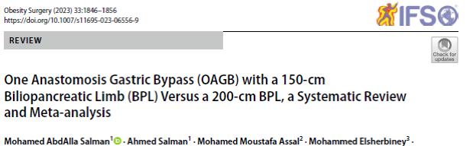

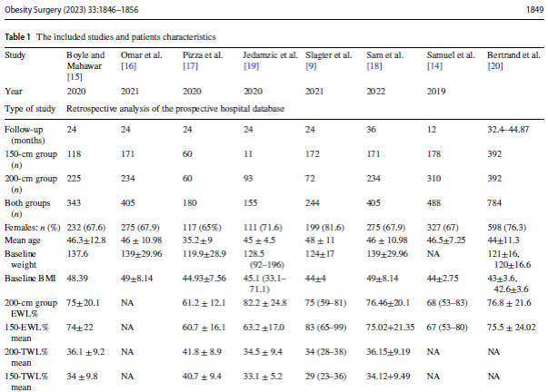
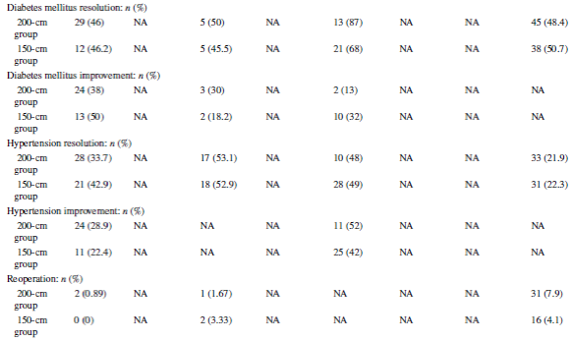
The total population number of the studies included in the
current review was 2599:
1100 (42.3%) OAGBwith a 150-cm BPL
1336 (51.4%) OAGBwith a 200-cm BPL
This review found that 200-cm BPL displayed better
weight loss outcomes with a significant difference in the TWL%.
There was comparable comorbidities remission.
Nutritional deficiency rates were higher in patients with a
200-cm BPL.
Significantly higher ferritin and folate deficiency rates were found in the 200-cm BPL group.
Considering a 200-cm BPL delivers a better weight loss outcome than a 150 –cm BPL, which is at the expense of a more severe nutritional deficiency.

Slide 14
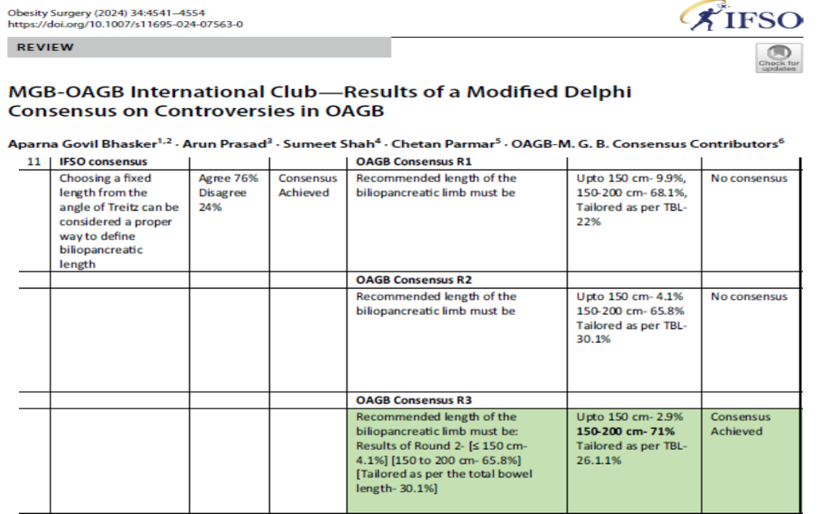



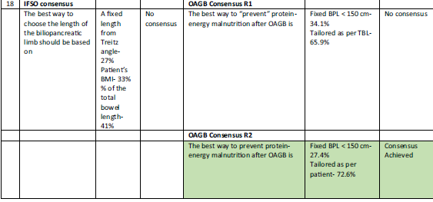

Slide 15
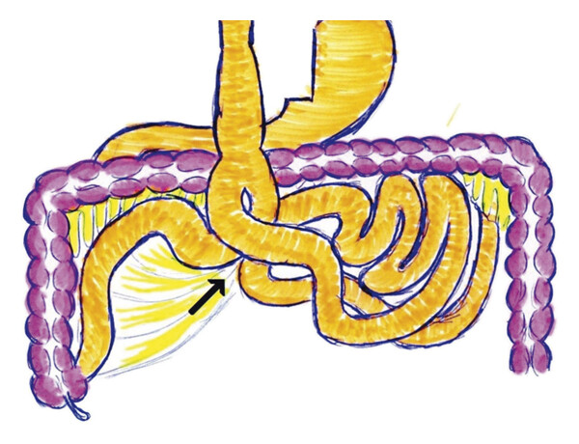
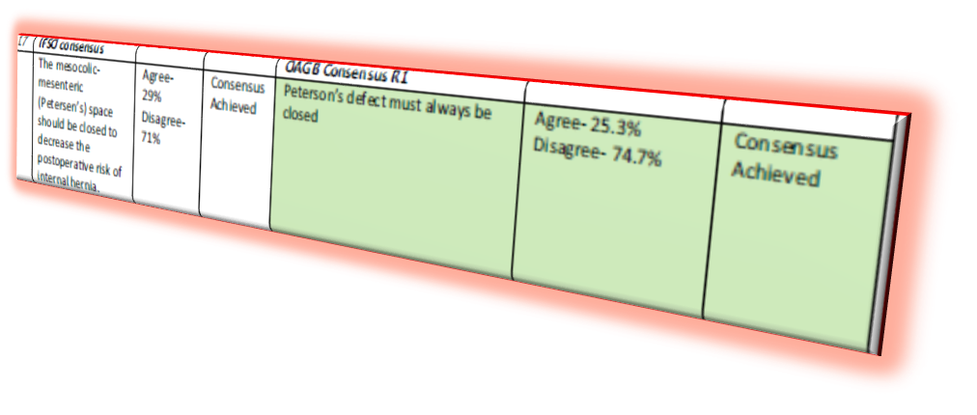
SPAZIO DI PETERSEN
La maggior parte dei chirurghi sono d’accordo nel non chiudere lo spazio di Petersen, in quanto molto grande e meno probabilità di ernia interna rispetto al RYGBP.
Rischio di ernia interna è di circa 1 /500 casi.
In letteratura sono descritti pochi casi di ernia interna
dopo OAGB/MGB, la maggior parte dei chirurghi non
chiude lo spazio di Petersen.
Uno studio di Mahawar et al. Mostra che solo il 18% dei chirurghi chiude lo spazio di Petersen durante OAGB/MGB; sebbene la sua chiusura previene il rischio di ernia interna, kinking, twisting e migrazione della pouch gastrica in torace
Areas of Non-Consensus Around One Anastomosis/Mini Gastric Bypass (OAGB/MGB): A Narrative Review Mohammad Kermansaravi et al., Obesity Surgery (2021) 31:2453–2463

Slide 16

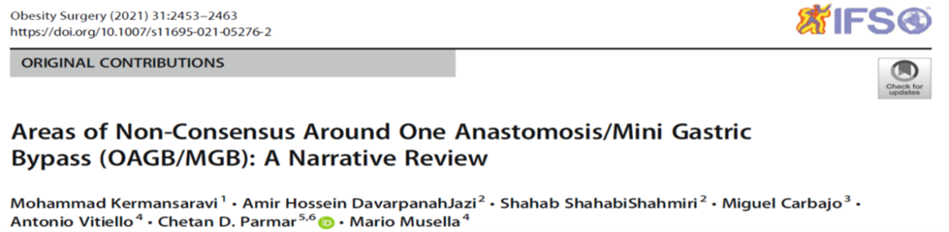
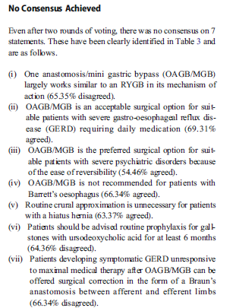
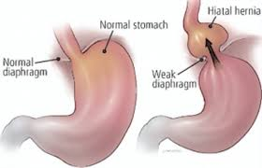
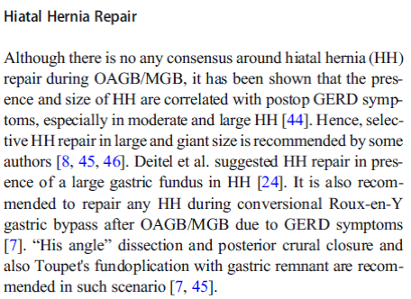
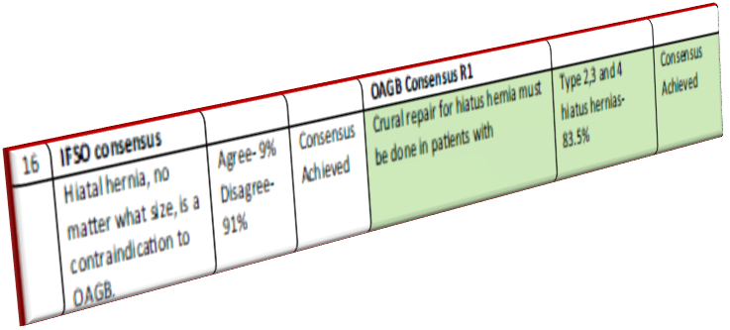

Slide 17

Since its inception in 1997, OAGB has been a subject of significant controversy, which has hindered its broader acceptance.
Consensus could be achieved on 22 out of 29 previously unresolved areas, certain areas continue to
require further research and clinical validation.
Consensus statements reflect the collective thought process and intentions of a scientific community striving for progress in the positive direction.
It is also important to note that consensus statements are not legally binding.
They are a set of recommended clinical suggestions.
The treatment must be tailored to individual patient in clinical practice.
Following the guidelines or consensus very rigidly may negatively impact the treatment for some patients and render it ineffective in some cases.
Furthermore, when referencing international guidelines or consensus statements, it is crucial to understand cultural,economic, ethnic differences across various countries or regions.
It is also important to understand the patient’s literacy and level of understanding as these contextual factors can significantly influence their applicability.
MGB‑OAGB International Club—Results of a Modified Delphi Consensus on Controversies in OAGB Aparna Govil Bhasker et al., Obesity Surgery (2024) 34:4541–4554

Slide 18


